Slide 1
Database Mangement System (DBMS)
Saurabh Puri

Slide 2
UNIT-1 : DBMS INTRODUCTION

Slide 3

Data
Data is a raw fact or unorganized form (such as alphabets, numbers, or symbols) that refers to or represent, condition, ideas or objects data is limitless and present everywhere in the universe.

Slide 4

Information
Data that
has been verified to be accurate and timely.
Is specific and organized for a purpose.
Is represented within a context that gives it meaning and relevance.
That can lead to an increase in
understanding and decrease in uncertainty is called information.

Slide 5
Database
A database is a collection of information that is organized so that it can easily be accessed managed and update. There are two type of database:
Conventional Database: Collection of data without use of computer. E.g. Telephone diary, register.
Computerized database: The collection of data with the help of computer in the form of data file is known as computerized database. The types of computer systems that can run database management system are Centralized PC and Client/Server and distributed.

Slide 6
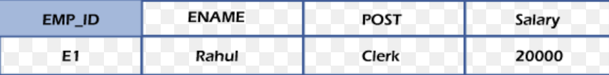
Elements of Database:
1. Field: Smallest unit of Database.
2. Record: A Collection of multiple related fields.
3. Table: A collection of records or group of records with the row and column order.
4. Tuple: A record row in the database.
5. Index: It is a process of organizing data in specific order.
6. Cell: A cell is a inter section of rows and columns.

Slide 7
Data base system
The data base data collection with DBMS is called database system. A database system is a way of organizing information on a computer, implemented by a set of computer programs. This kind of organization should offer:
simplicity - an easy way to collect, access-connect, and display information.
stability - to prevent unnecessary loss of data.
security - to protect against unauthorized access to private data.
speed - for fast results in a short time, and for easy maintenance in case of changes in the organization that stores the information.

Slide 8
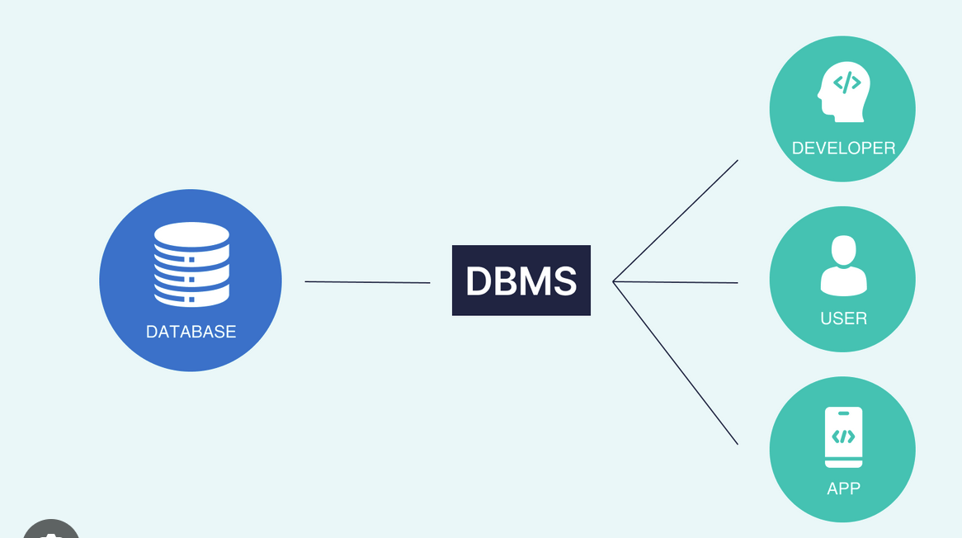
DBMS (Database management system):
DBMS is a software that defines a database, stores the data, support a query language, produced reports and create data entry screen. Some useful Database Management System softwares are Ms-Access, SQL/SQL PLUS, dbase, FoxPro, Sybase, Oracle, IMS, IDS, IDMS,AdaBASE, CDS/ISIS, OMNIS, RBASE, FOXBASE.

Slide 9
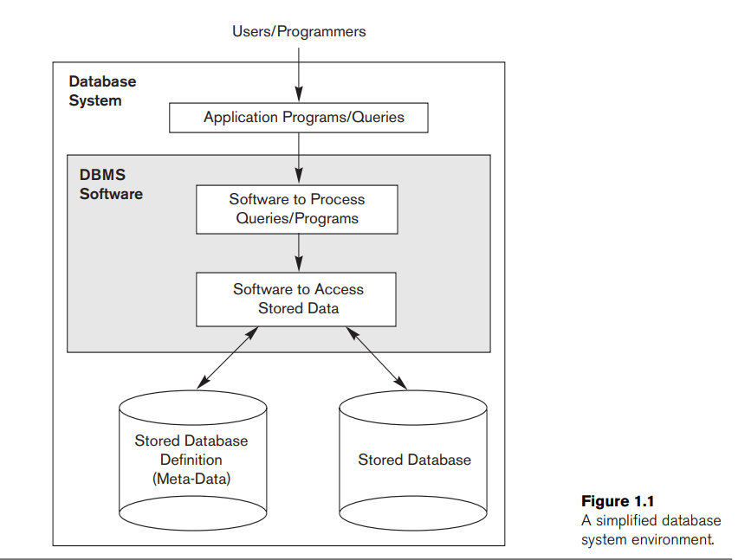
Database Environment
An Application Program accesses the database by sending queries or requests for data to the DBMS
A Query typically causes some data to be retrieved; a transaction may cause some data to be read and some data to be written into the database.

Slide 10
Advantages of DBMS
Controlling data redundancy.
Elimination of inconsistency.
Betters service to the user.
Flexibility of the system is improved.
Integrity can be improve.
Standards can be enforced .
Security can be improved.
Provides backup and recovery

Slide 11

Disadvantage of DBMS
Database system are complex, difficult, and time consuming to design.
Extensive conversion costs in moving from a file system to a database system.
Initial training required for all programmers and users.

Slide 12
APPLICATION DEVELOPMENT WITHOUT DATABASE:
Application development would be complicated and would cause the serious problems during the data access, without a good database system.Programs need to store data and retrieve those stored data later in future when required. Using the traditional file processing system to store the data can cause various problems, some of problems described below :
Data redundancy
Program/data dependency
Lack of flexibility
Poor programmer productivity
Excessive program maintenance

Slide 13
Centralised and Client/Server Architecture
For DBMS

Slide 14
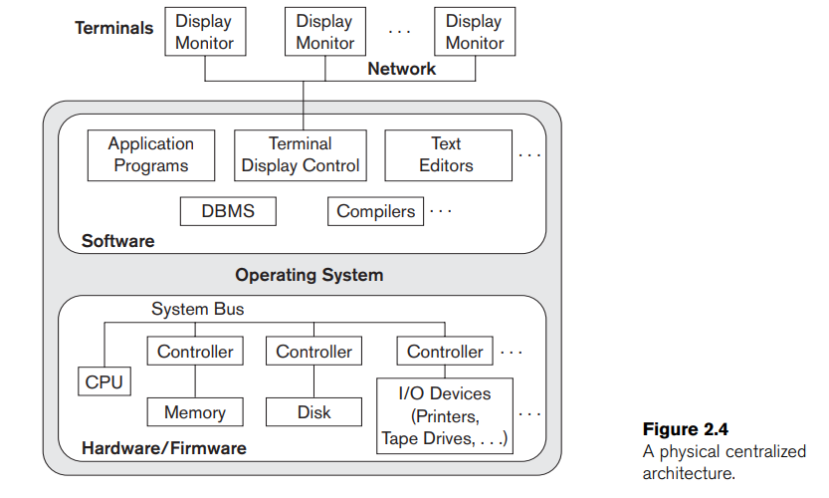
Centralised Architecture
A centralized DBMS in which all the DBMS functionality, application program execution, and user interface processing were carried out on one machine.
Database systems used these computers similarly to how they had used display terminals, so that the DBMS itself was still a centralized DBMS

Slide 15
Client/Server Architecture
The concept of client/server architecture assumes an underlying framework that consists of many PCs as well as a smaller number of mainframe machines, connected via LANs and other types of computer networks.
A client in this framework is typically a user machine that provides user interface capabilities and local processing.
When a client requires access to additional functionality, such as database access which does not exist at that machine, it connects to a server that provides the needed functionality.
A Server is a system which contains both Hardware and Software which provides services to client Machines like file access, printing and database access.
There are two types of Client/Server Architecture: Two-Tier and Three-Tier

Slide 16
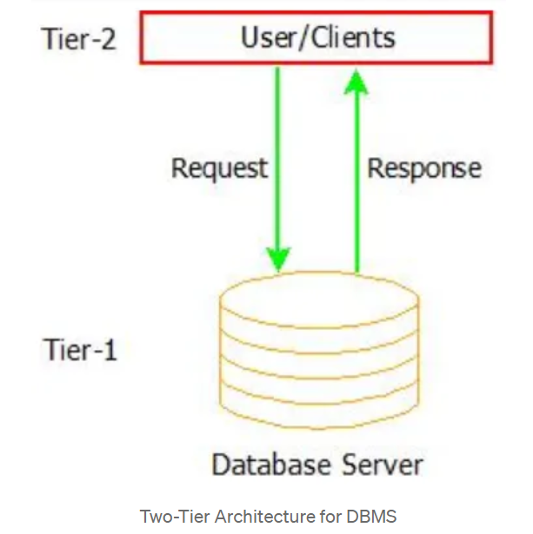
Two-Tier Client/Server Architecture for DBMS
Two-tier means that our Architecture has two layers, which are client layer and Datalayer.
In Client layer we have several Client machines which can have the access to the database server.
The API present on the client machine will establish the connection between the machine and the Database server through JDBC or something else.This is because Clients and Database Server may be at different different locations.
Once this connection gets established,the Interface present on the client machine contains an Application Program on the back-side which contains a query. This query will be processed by the Database server and in turn the queried information will be sent to the client machine.
For example if we query the database to retrieve some information, the query will be Processed by Database server and that information will be sent to the client by Database server itself.

Slide 17
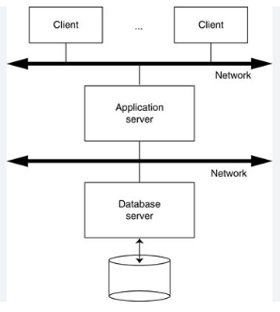
Three-Tier Client/Server Architecture for DBMS
An additional layer which acts as an intermediate between Client layer and Datalayer called Business logic layer.
Business logic layer is the layer where the Application Programs are processed.
Here the Application Programs are processed in the Application server itself, which makes it different from Two-tier Architecture where queries are processed in the database server.
Simply the Client machines will contact Application Server which in turn processes our Application Programs and fetches the Required Data from Database and then sends this Information back to the client machine in the suitable format only.

Slide 18
Advantages of Three-Tier over Two-Tier
Even it is easy to maintain Two-Tier Architecture of DBMS it is still not scalable when we have large number of clients.
Also not secure because the clients are having direct access to database server.
Three-Tier Architecture ensures Scalability and Security of the data because of the presence of this Intermediate layer
As the Business layer processes the queries and it just retrieves data from server instead of processing in the server to take place.
There are n-tier Architectures possible like 4-tier,5-tier and so on…

Slide 19
Data Independence :
Data independence is usually consisting from the two points of view.
(i) Physical Data independence
(ii) Logical data independence
Physical data independence allows changes in the physical storage devices or organization of the file to be mode without requiring changes in the concept view or any of the external view and hence in the application program using database.
Moving the database to a different storage device (e.g., from HDD to SSD).
Changing the file organization method (e.g., from heap to B+ tree).
Adding or removing indexes.
Modifying compression techniques.

Slide 20
Logical data independence
Logical data independence :
The ability to change the logical (conceptual) schema without changing the External schema (User View) is called logical data independence. For example, the addition or removal of new entities, attributes, or relationships to the conceptual schema should be possible without having to change existing external schemas or having to rewrite existing application programs.
Examples:
Adding a new attribute to an existing entity (e.g., adding a "middle name" field to a "customer" table).
Splitting an entity into two (e.g., separating "address" into "street" and "city").
Combining two entities into one (e.g., merging "customer" and "order" tables).

Slide 21
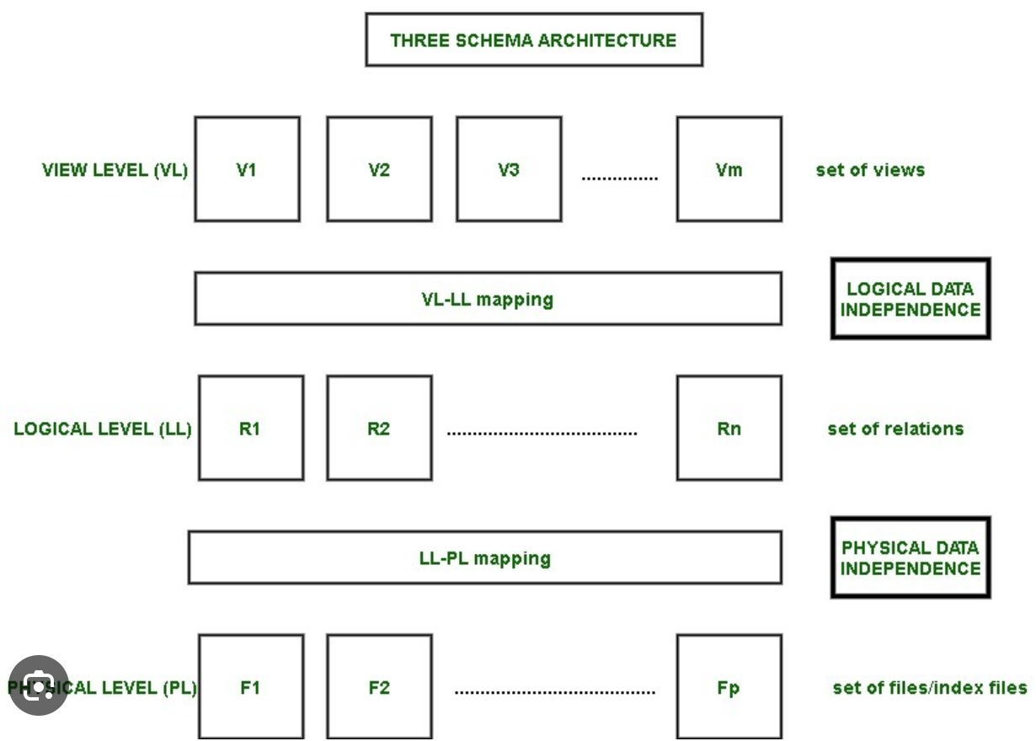

Slide 22
UNIT-2 DATABASE DESIGNING

Slide 23
Data Abstraction provided by DBMS
One fundamental characteristic of the database approach is that it provides some level of data abstraction.
Data abstraction generally refers to the suppression of details of data organization and storage, and the highlighting of the essential features for an improved understanding of data.
One of the main characteristics of the database approach is to support data abstraction so that different users can perceive data at their preferred level of detail.

Slide 24
Database design
Database design is the process of producing a detailed data model of a database. This logical data model contains all the needed logical and physical design choices and physical storage parameters needed to generate a design in a Data Definition Language, which can then be used to create a database. A fully attributed data model contains detailed attributes for each entity. The term database design can be used to describe many different parts of the design of an overall database system.

Slide 25
Data Modelling
Data model is a collection of conceptual tools used for describing data, data relationships
and data constraints. The model should enable the designer to incorporate a major
portion of semantics of the database in the system.
Key Points :
Database design is the blueprint for a successful DBMS, ensuring efficient data organization and retrieval.
Different models provide varying levels of abstraction and functionality for structuring data.
Understanding these models empowers you to choose the best fit for your specific needs.

Slide 26
Object based data model
Object based data model are used in describing data and data relationship in accordance with concept. In general, the object based data models are gaining wide acceptance for their flexible structuring capabilities. The Entity relationship model which is an object based model is widely used in practices as an appropriate database design tool

Slide 27
Conceptual data model
It identifies the highest-level relationships between the different entities. Features of conceptual data model include:
– Includes the important entities and the relationships among them.
– No attribute is specified.
– No primary key is specified.

Slide 28
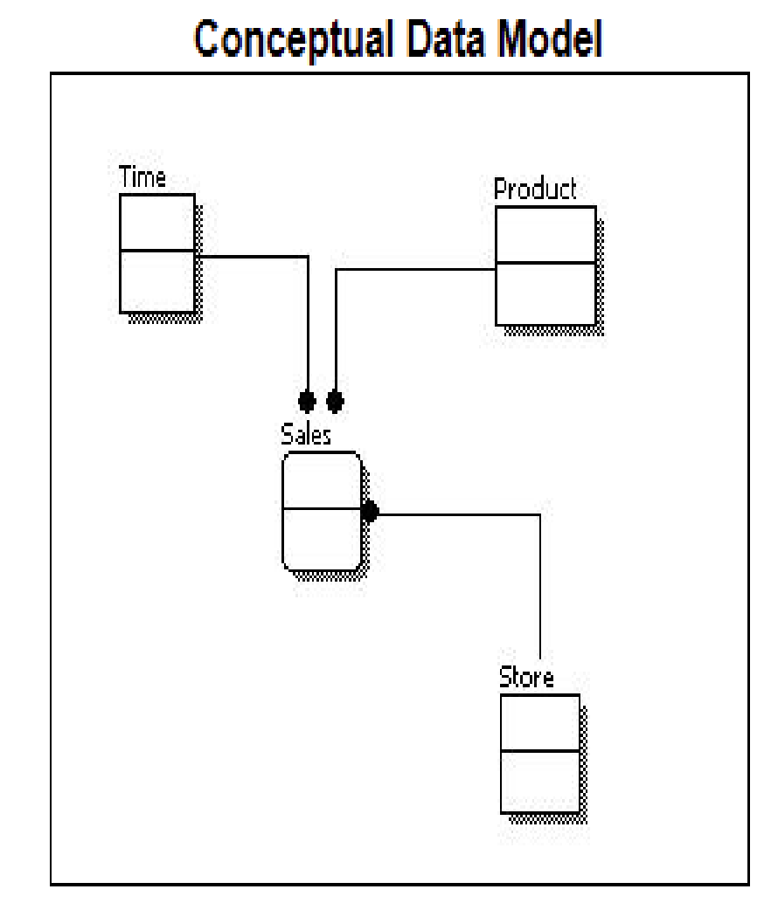

Slide 29
Logical data model
It describes the data in as much detail as possible, without regard to how they will be physical implemented in the database. Features of a logical data model include:
– Includes all entities and relationships among them.
– All attributes for each entity are specified.
– The primary key for each entity is specified.
– Foreign keys (keys identifying the relationship between different entities) are specified.
– Normalization occurs at this level.

Slide 30
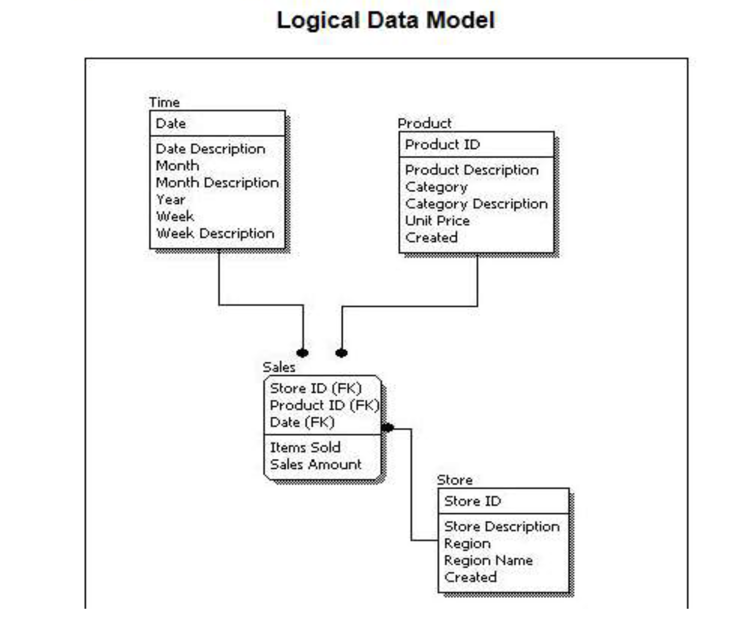

Slide 31
Representational Data Model
This type of data model is used to represent only the logical part of the database and does not represent the physical structure of the database.
The representational data model allows us to focus primarily, on the design part of the database. A popular representational model is a Relational model.
The relational Model consists of Relational Algebra and Relational Calculus. In the Relational Model, we basically use tables to represent our data and the relationships between them. It is a theoretical concept whose practical implementation is done in Physical Data Model.
The advantage of using a Representational data model is to provide a foundation to form the base for the Physical model
Structured Query Language (SQL) is used to practically implement Relational Algebra.

Slide 32
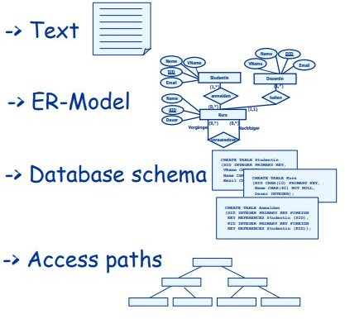
Steps In Developing a Database ?
Requirements analysis
Conceptual Database design
Logical Database design
Physical Database design
Applications and security

Slide 33
UNIT - 3 Entity Relationship Model

Slide 34
ER Model
What we need to know ?
What are the entities and relationships in the enterprise?
What information about these entities and relationships should we store in the database?
What are the integrity constraints or business rules that hold?
A database `schema’ in the ER Model can be represented pictorially (ER diagrams).
Can map an ER diagram into a relational schema.

Slide 35
ER Model - ENTITY
Real-world object distinguishable from other objects.
For example, each student in a university is an entity
An entity is described using a set of attributes.
Each attribute has a domain.
Each entity has a value for each of its attributes.
For example, a particular student entity have the value 12321 for
Roll No., the value Shyam for name

Slide 36
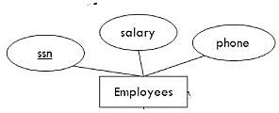
ER Model - ENTITY SET
Set of entities of the same type that share the same properties, or attributes. The set of all employees at a given university, for example can define the entity set employees.
Each entity set has a key.

Slide 37
Minimal set of attributes which uniquely identify an instance of a entity
Many candidate keys choose one to be a primary keys

Slide 38
ER Model - RELATIONSHIPS
Relationship
Association among two or more entities. For example, we can define a relationship works in that associate's employee Ram with department Computer Science
Relationships have
A name
A set of entities that participate in them
A degree - the number of entities that participate (most have degree 2)
A cardinality ratio

Slide 39
Each entity in a relationship can participate in zero, one, or more than one instances of that relationship
This leads to 3 types of relationship
One to one (1:1)
Each lecturer has a unique office
One to many (1:M)
A lecturer may tutor many students, but each student has just one tutor
Many to many (M:M)
Each student takes several modules, and each module is taken by several students

Slide 40
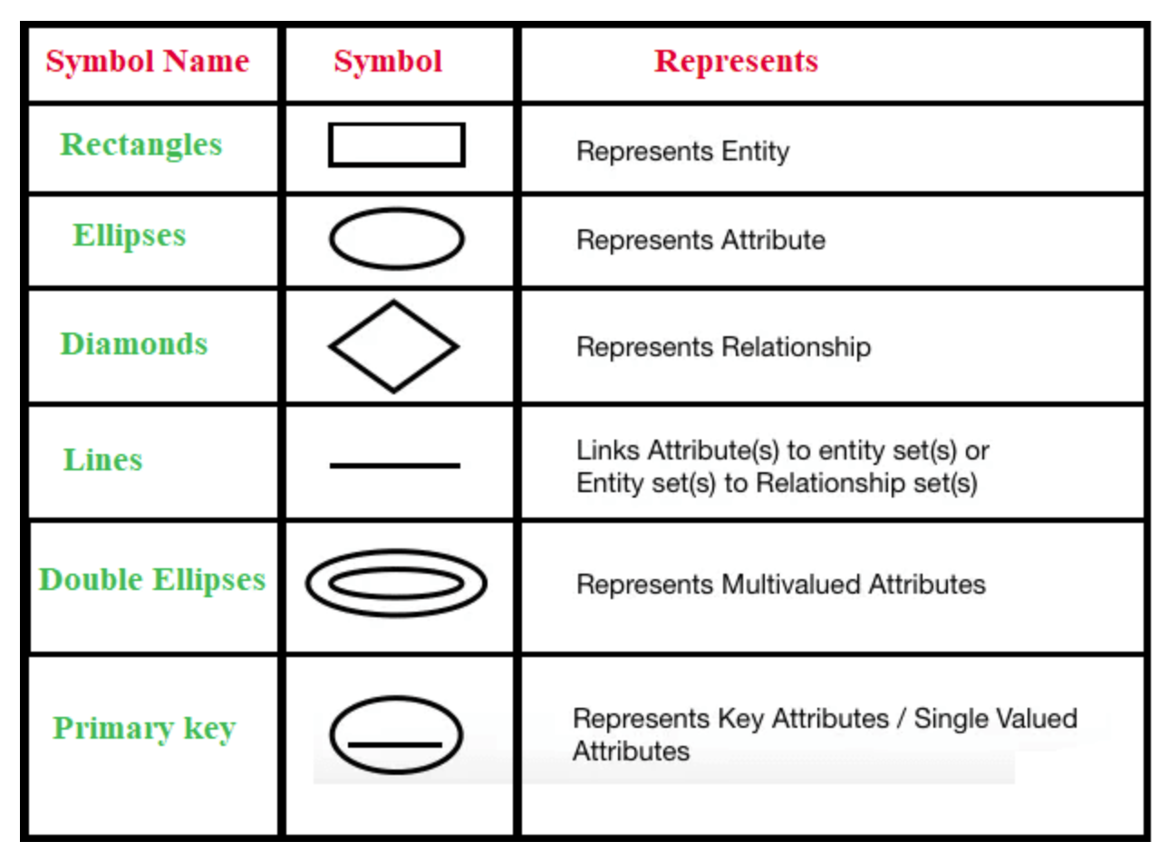
Entity Relationship Diagram Symbols

Slide 41
Problem Statement
Certainly! Let's consider a simplified ER (Entity-Relationship) model for a music store that includes entities such as Artist, Album, Genre, and Customer
An Artist can be associated with multiple Albums
An Artist can belong to multiple Genres
An Album is created by one Artist
An Album can belong to multiple Genres.
A Genre can be associated with multiple Artists.
A Genre can be associated with multiple Albums.
A Customer can purchase multiple Albums

Slide 42
An Artist creates multiple Albums. (1:M relationship)
An Album is associated with exactly one Artist.
An Artist can have zero or more associated Albums.
An Artist can belong to multiple Genres, and a Genre can have multiple associated Artists. (M:N relationship)
An Artist can be associated with multiple Genres.
A Genre can be associated with multiple Artists.
An Album is created by one Artist, and an Artist can create multiple Albums. (M:1 relationship)
An Album is associated with exactly one Artist.
An Artist can create zero or more Albums.
An Album can belong to multiple Genres, and a Genre can have multiple associated Albums. (M:N relationship)
An Album can be associated with multiple Genres.
A Genre can be associated with multiple Albums.
A Customer can purchase multiple Albums, and an Album can be purchased by multiple Customers. (M:N relationship)
A Customer can be associated with multiple Albums.
An Album can be purchased by multiple Customers

Slide 43
ER- Entities
Artist
Album
Genre
Customer

Slide 44
Problem Statement
Develop an ER diagram for a food delivery app named "Foodie Express" that connects restaurants, diners, and delivery personnel. The system should manage orders, track deliveries, and handle user accounts and payments.
A diner can place multiple orders from different restaurants.
An order belongs to one diner and one restaurant.
An order can be assigned to one delivery person.
A delivery person can handle multiple orders.
An order can contain multiple order items.
An order item references one item from a restaurant menu.
A restaurant offers many items in its menu.
A diner can write multiple reviews for different restaurants.
A review is associated with one diner, one restaurant, and one order.

Slide 45
ER MODEL Entities :
Restaurants
Diners
Delivery Personnel
Orders
Order Items
Items
Reviews

Slide 46
Restaurants: (restaurant_id, name, cuisine, address, phone, logo, rating)
Diners: (diner_id, name, email, phone, address, payment_methods)
Delivery Personnel: (delivery_person_id, name, phone, vehicle_type, rating)
Orders: (order_id, diner_id, restaurant_id, delivery_person_id, order_date, order_time, status, total_price)
Order Items: (order_item_id, order_id, item_id, quantity, price)
Items: (item_id, restaurant_id, name, description, price, image)
Reviews: (review_id, diner_id, restaurant_id, order_id, rating, comment)

Slide 47
DINER
Delivery Personnel
1:M
ORDERS
M:1
1:M
1:M
1:M
ITEMS
RESTRAUNTS
M:1
1:M
M:1
ORDERS ITEM
REVIEWS
1:M

Slide 48
UNIT-4 Relational Databases

Slide 49
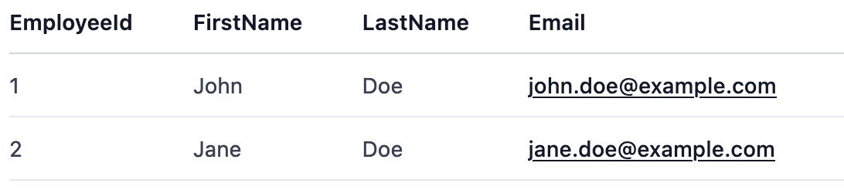
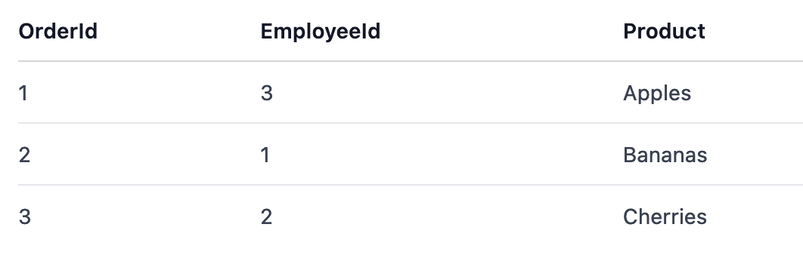
Relational Databases
A relational database is a type of database that stores and organizes data in a structured way.
Data in a relational database is stored in various data tables, each of which has a unique key identifying every row.

Slide 50
SQL vs No-SQL Databases
SQL (Structured Query Language) databases are also known as relational databases. They have a predefined schema, and data is stored in tables consisting of rows and columns.
NoSQL (Not only SQL) databases refer to non-relational databases, which don’t follow a fixed schema for data storage. Instead, they use a flexible and semi-structured format like JSON documents, key-value pairs, or graphs.

Slide 51
SQL Advantages & Disadvantages
Predefined schema: Ideal for applications with a fixed structure.
ACID transactions: Ensures data consistency and reliability.
Support for complex queries: Rich SQL queries can handle complex data relationships and aggregation operations.
Rigid schema: Data structure updates are time-consuming and can lead to downtime.
Scaling: Difficulties in horizontal scaling and sharding of data across multiple servers.

Slide 52
ACID PROPERTIES :
Atomicity:
Definition: Atomicity ensures that a transaction is treated as a single, indivisible unit of work. Either all the changes made by the transaction are committed to the database, or none of them are.
Example:
Consider a bank transfer where money is withdrawn from one account and deposited into another. The transaction involves two operations: debit from one account and credit to another. Atomicity ensures that either both debit and credit operations succeed, or neither of them occurs. If, for example, the debit operation succeeds but the credit fails, the entire transaction is rolled back to maintain consistency.

Slide 53
Consistency
Definition: Consistency ensures that a transaction brings the database from one valid state to another. The database must satisfy a set of integrity constraints before and after the transaction.
Example:
Suppose a database has a constraint that ensures the total balance of all accounts is always a constant value. If a transaction violates this constraint (e.g., due to a bug or error), the system ensures that the transaction is rolled back, and the database remains in a consistent state. Consistency guarantees that the database transitions between valid states.

Slide 54
Isolation
Definition: Isolation ensures that the execution of one transaction is isolated from the execution of other transactions. Each transaction appears to be the only transaction executing on the database, even though there may be multiple transactions happening concurrently.
Example:
Consider two transactions, A and B, both trying to read and update the same set of data concurrently. Isolation ensures that the result of transaction A is not visible to transaction B until A is committed. This prevents interference between transactions and ensures the correctness of the overall system.

Slide 55
Durability
Definition: Durability guarantees that once a transaction is committed, its effects persist even in the event of a system failure such as a power outage or a crash.
Example:
After a user makes a transfer between accounts and the transaction is successfully committed, the changes (debit and credit) must be permanently stored in the database. Even if the system crashes immediately after the commit, when the system is restored, the changes made by the committed transaction should still be present in the database.

Slide 56
Assignment : SQL Databases & ACID Props
https://docs.google.com/forms/d/1CMWOAlh5TkLcJIjNj7GCMflh59QJ0JqY7MS7UpT4z5g/edit

Slide 57
UNIT-5 : SQL

Slide 58
Data Types In SQL
SQL data types define the type of data that can be stored in a database table’s column. Depending on the DBMS, the names of the data types can differ slightly. Here are the general types:
INT is used for whole numbers. For example:
VARCHAR is used for variable-length strings. For example:
DATE is used for dates in the format (YYYY-MM-DD).
DATETIME is used for date and time values in the format (YYYY-MM-DD HH:MI:SS).
BOOLEAN is used for boolean values (TRUE or FALSE).

Slide 59
Data Constraints
Data constraints in SQL are used to specify rules for the data in a table. Constraints are used to limit the type of data that can go into a table. This ensures the accuracy and reliability of the data in the table.

Slide 60
Candidate Key
•In a table, a candidate key is a minimal set K of attributes such that no two tuples are allowed to be equivalent on all the attributes in K.

Slide 61
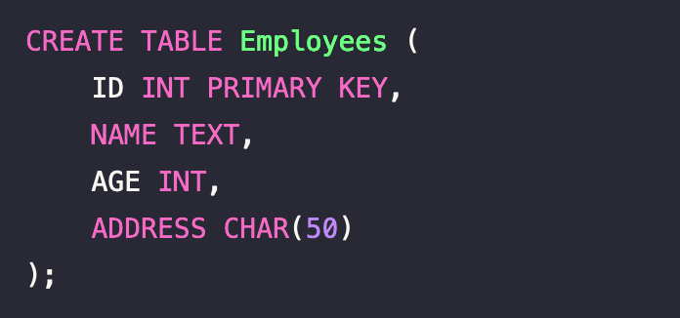
Primary Key
A primary key is a special relational database table field (or combination of fields) designated to uniquely identify all table records.
A primary key’s main features are:
It must contain a unique value for each row of data.
It cannot contain null values.
Usage of Primary Key
You define a primary key for a table using the PRIMARY KEY constraint. A table can have only one primary key. You can define a primary key in SQL when you create or modify a table.

Slide 62
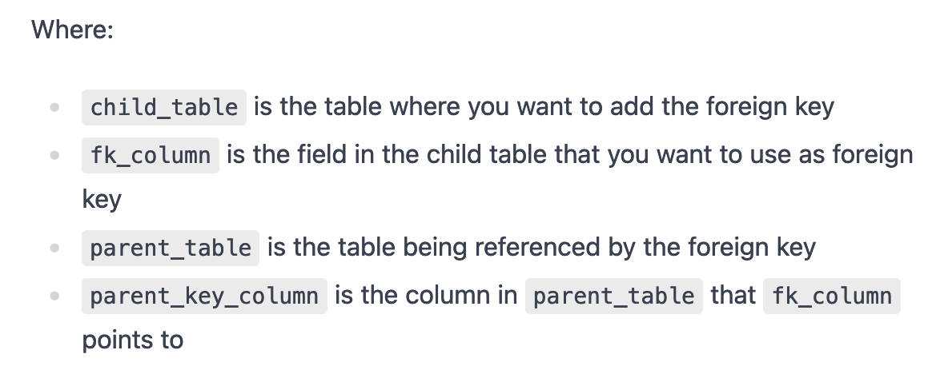
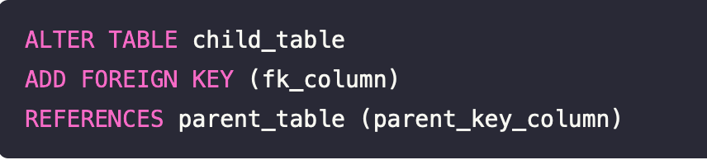
Foreign Key
A foreign key is a key used to link two tables together. It is a field (or collection of fields) in one table that refers to the primary key in another table. The table with the foreign key is called the child table, and the one with the primary key is called the referenced or parent table.
Basic Syntax
The SQL used to add a foreign key constraint is:

Slide 63
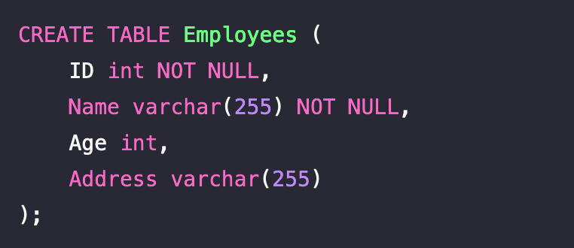
NOT NULL
The NOT NULL constraint in SQL ensures that a column cannot have a NULL value. Thus, every row/record must contain a value for that column. It is a way to enforce certain fields to be mandatory while inserting records or updating records in a table.
For instance, if you’re designing a table for employee data, you might want to ensure that the employee’s id and name are always provided. In this case, you’d use the NOT NULL constraint.
Creating a table with NOT NULL
Here’s an example of how you would define a NOT NULL constraint when creating a table:

Slide 64
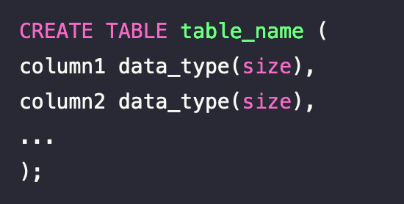

DDLs In SQL
Data Definition Language (DDL) is a subset of SQL. Its primary function is to create, modify, and delete database structures but not data. The commands in DDL are:
CREATE: This command is used to create the database or its objects
DROP: This command is used to delete an existing database or table.

Slide 65
ALTER: This is used to alter the structure of the database. It is used to add, delete/drop or modify columns in an existing table.
RENAME: This is used to rename an object in the database.

Slide 66
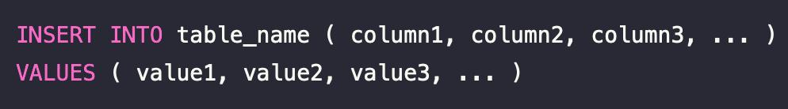
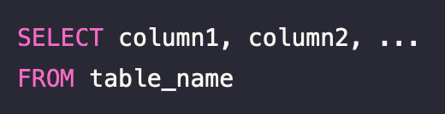
DML In SQL
DML is a subcategory of SQL which stands for Data Manipulation Language. The purpose of DML is to insert, retrieve, update and delete data from the database.
INSERT INTO - This command is used to insert new rows (records) into a table.
SELECT - This command is used to select data from a database. The data returned is stored in a result table, called the result-set.

Slide 67
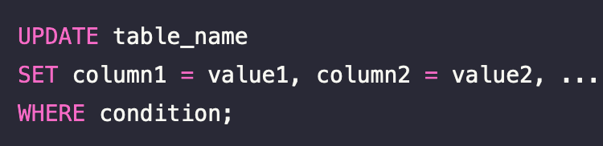
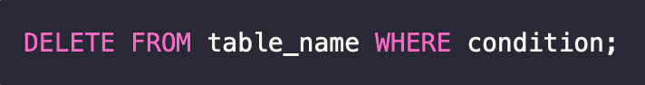
UPDATE - This command is used to modify the existing rows in a table.
DELETE FROM - This command is used to delete existing rows (records) from a table.

Slide 68
SQL Hands ON !!
Q1 . Create a database named “school” .
Q2. Create a table “student”. A student info comprises of id, name, age.
Q3. Add a column to student table named “total_marks”.
Q4. Add 3 students to student table.

Slide 69
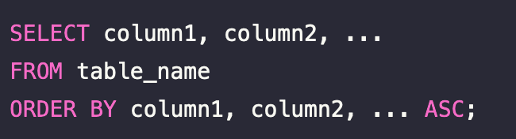
Order By Clause :
The ORDER BY clause in SQL is used to sort the result-set from a SELECT statement in ascending or descending order. It sorts the records in ascending order by default.

Slide 70
Comparison Operators
Comparison Operators, sometimes referred to as relational or boolean operators, compare values in a database and determine if they are equal (=), not equal (!=, <>), greater than ( >), less than (<), greater than or equal to (>=), and less than or equal to (<=). They are used in conditions within SQL statements, such as in the WHERE clause.

Slide 71
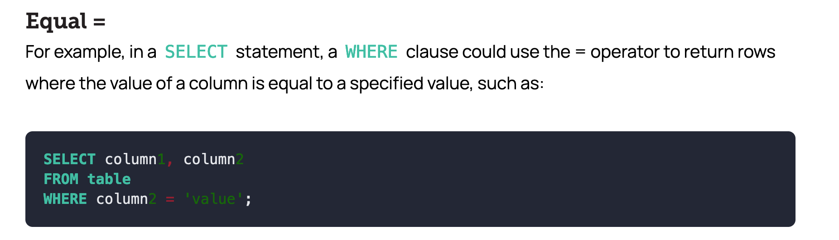

Slide 72
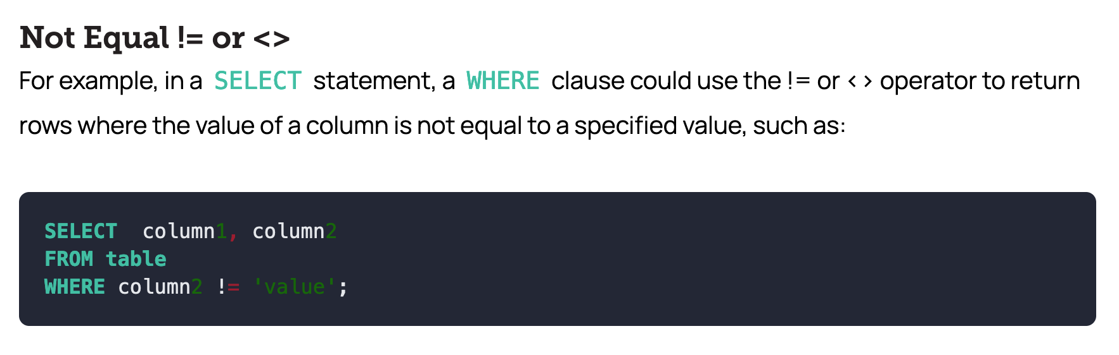

Slide 73
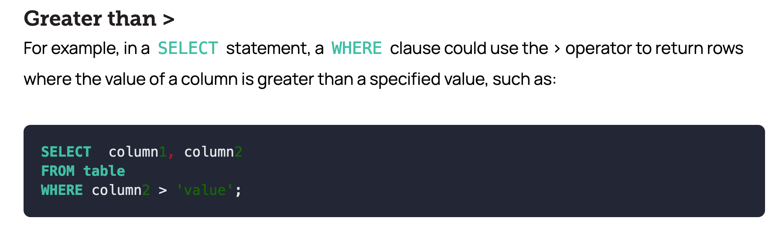

Slide 74
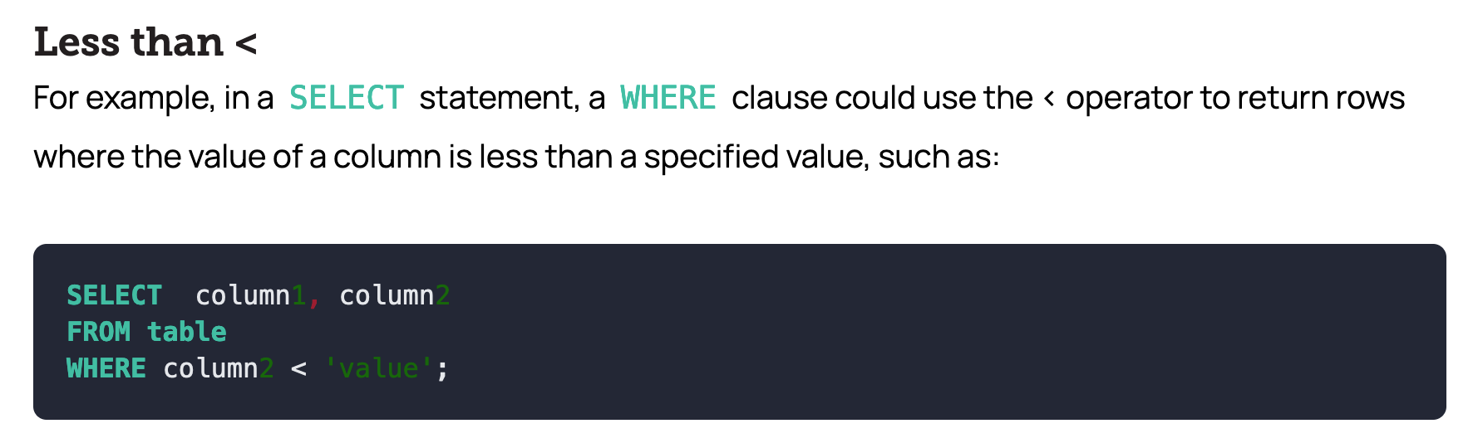

Slide 75
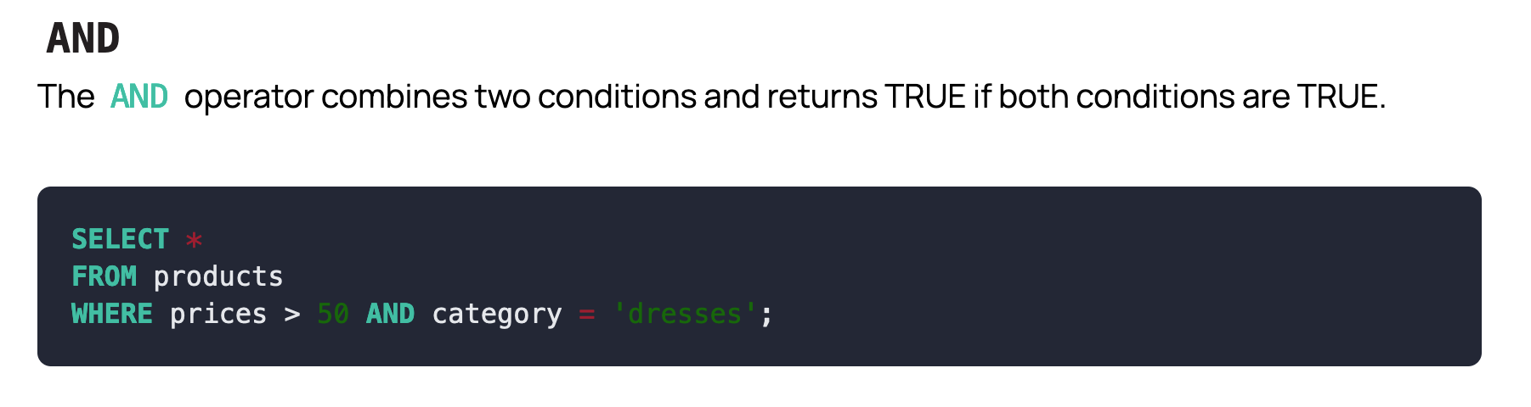
Logical Operators
SQL Logical Operators combine conditions in a WHERE clause to create more complex expressions. Operators in SQL can be symbols or keywords used to perform operations on data. They perform various tasks in SQL statements, such as filtering, combining, and modifying data.

Slide 76
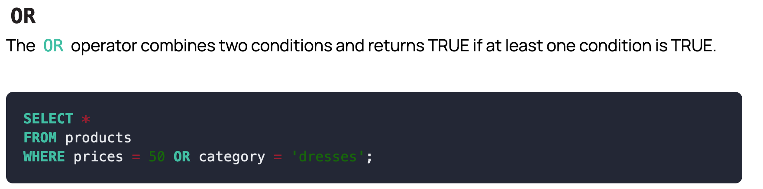
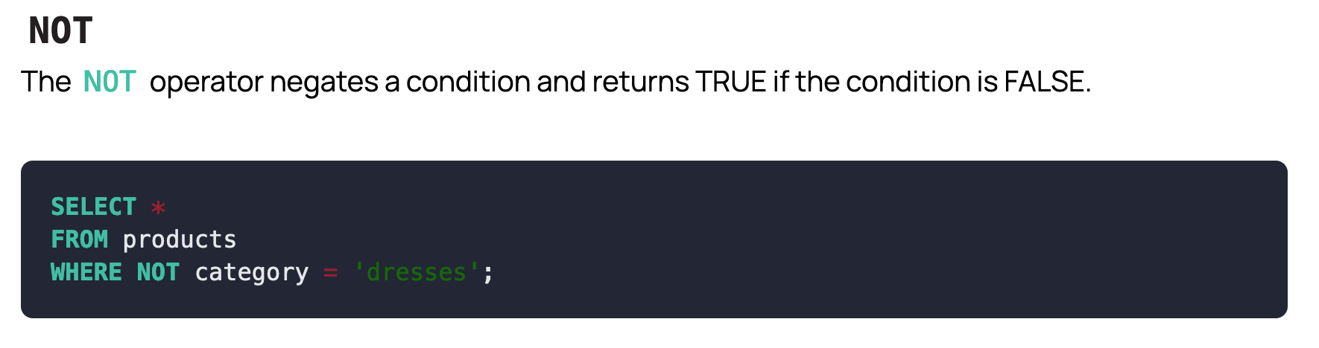

Slide 77
Assignment
Comparison & Logical Operators
https://docs.google.com/forms/d/1Idnvu-2MbJZ2oH9hrHxjED2LJ5VXFzc0TapFawS1fUI/

Slide 78

Aggregate Functions
SUM
The SUM() function in SQL is used to calculate the sum of a column. This function allows you to add up a column of numbers in an SQL table.
The syntax for SUM is as follows:

Slide 79
COUNT
COUNT is a SQL function that returns the number of rows that match a specified criteria. Essentially, COUNT function is used when you need to know the count of a record in a certain table’s column.
There are two types of count function; COUNT(*) and COUNT(column).
COUNT(*) counts all the rows in the target table whether columns contain null values or not.
SELECT COUNT(*) FROM table_name;
COUNT(column) counts the rows in the column of a table excluding null.
SELECT COUNT(column_name) FROM table_name;

Slide 80
AVG
The AVG() function in SQL is an aggregate function that returns the average value of a numeric column. It calculates the sum of values in a column and then divides it by the count of those values.
Syntax:
SELECT AVG(column_name)
FROM table_name;
This statement will return the average value of the specified column.

Slide 81
MAX
The MAX() function in SQL is used to return the maximum value of an expression in a SELECT statement.
It can be used for numeric, character, and datetime column data types. If there are null values, then they are not considered for comparison.
Syntax
SELECT MAX(column_name)
FROM table_name
WHERE condition;
In this syntax, the column_name argument is the column in the table_name that you wish to find the maximum value of.
Same MIN function is used to return the minimum value

Slide 82
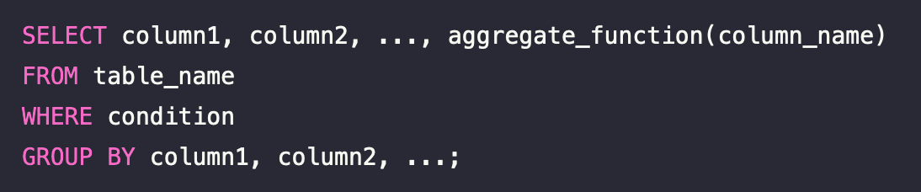
Aggregate Queries :
Group By is an SQL clause that arranges identical data into groups. It is often used with aggregate functions (COUNT, MAX, MIN, SUM, AVG) to group the result-set by one or multiple columns.

Slide 83
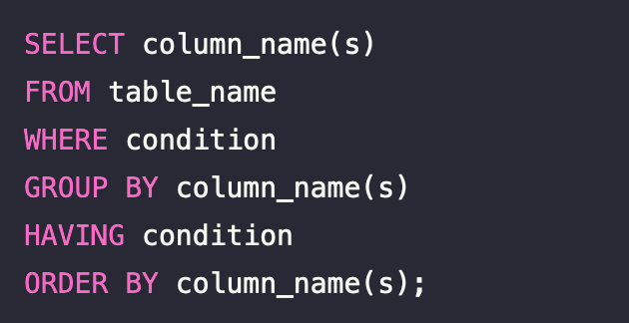
HAVING
The HAVING clause is used in combination with the GROUP BY clause to filter the results of GROUP BY. It is used to mention conditions on the group functions, like SUM, COUNT, AVG, MAX or MIN.
It’s important to note that where WHERE clause introduces conditions on individual rows, HAVING introduces conditions on groups created by the GROUP BY clause.
Also note, HAVING applies to summarized group records, whereas WHERE applies to individual records.
Syntax:

Slide 84
SQL - Aggregate Functions
https://docs.google.com/forms/d/e/1FAIpQLScb0Z9isbPMV5-cGyiRCZUd3-aXrqRty2TIH8Ec3MLTr91TPQ/viewform?usp=sf_link

Slide 85
SELECT AVG(age) AS average_age FROM student;
SELECT MAX(marks) AS max_marks_math FROM student WHERE course = 'Math';
SELECT course, COUNT(*) AS num_students FROM student GROUP BY course;
SELECT name, SUM(marks) AS total_marks FROM student GROUP BY name;
SELECT name, age FROM student ORDER BY age DESC LIMIT 1;
SELECT course, AVG(marks) AS avg_marks FROM student GROUP BY course

Slide 86
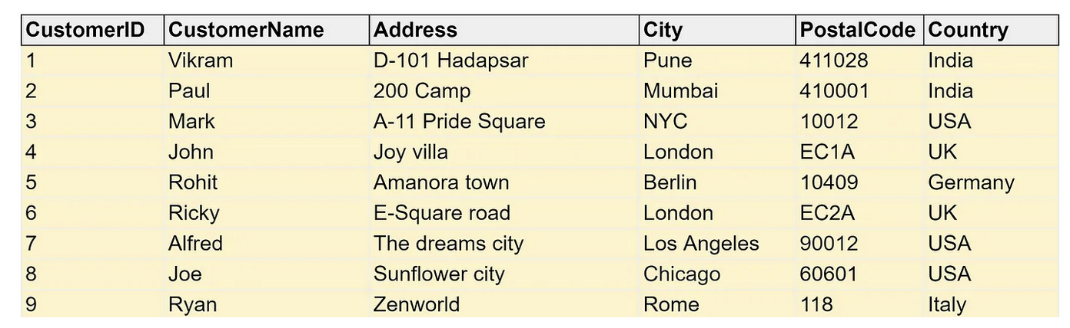
Interview Stuff (Excited ?)
list the number of customers in each country and sorts the result set from high to low.
lists the number of customers in each country and sorts the result set from high to low having the count of customers greater than 1.

Slide 87
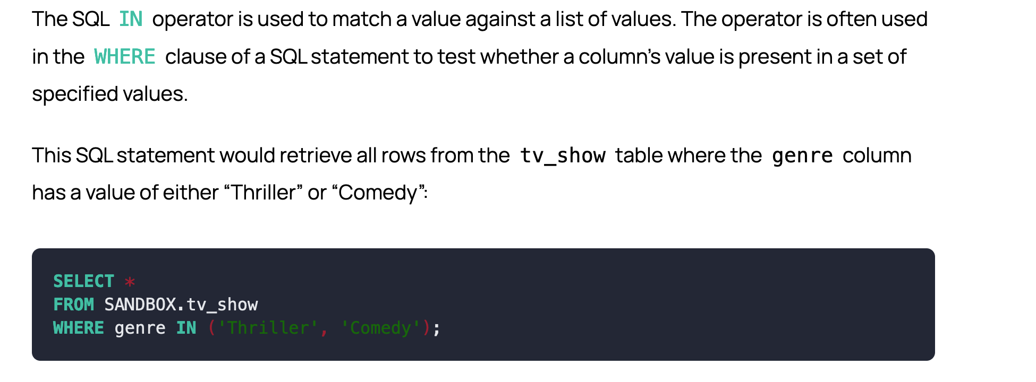
IN Operator

Slide 88
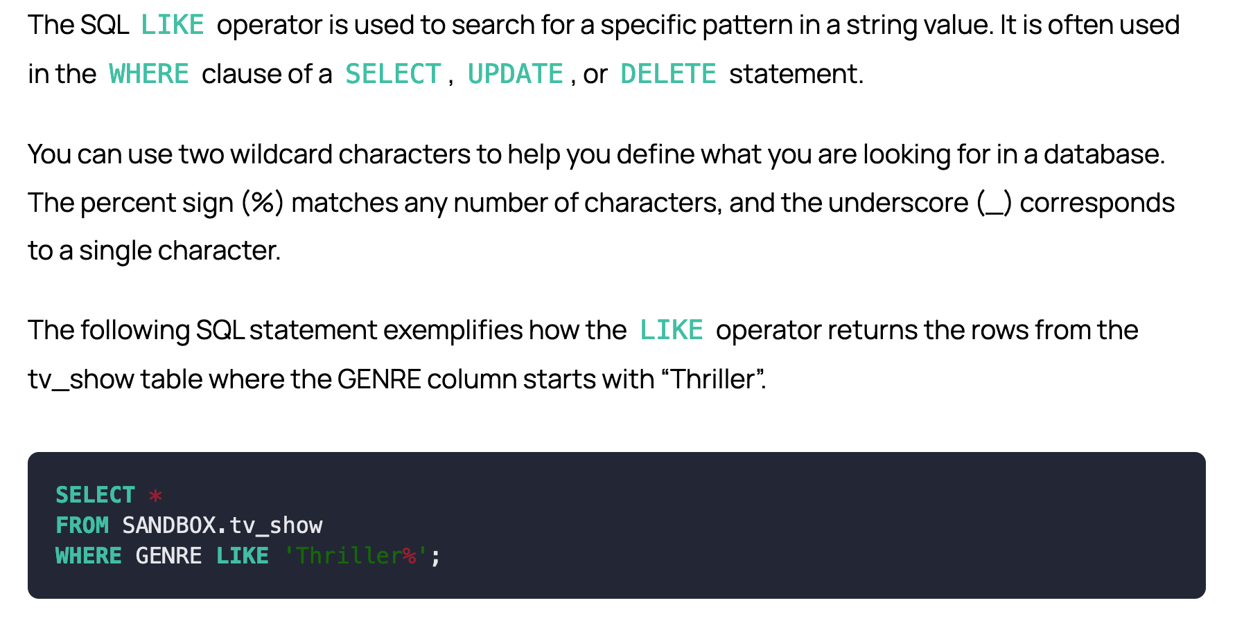
LIKE Operator

Slide 89
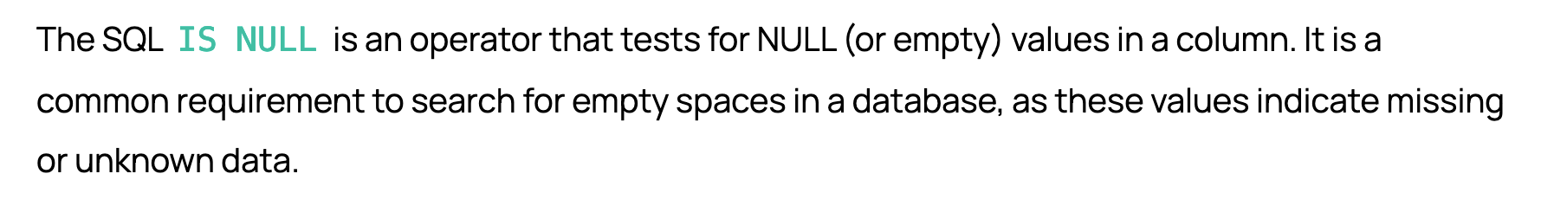
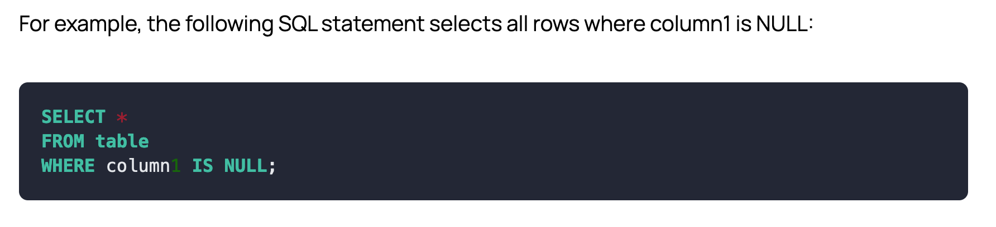
NULL Operator

Slide 90
SQL - NULL, LIKE, IN
Consider the student database with columns : [id, name, course, marks, age]
Retrieve the names of students who are enrolled in either 'Math' or 'English' courses.
Retrieve the names of students whose names start with the prefix 'J'.
Retrieve students who do not have an address specified in the database.
Retrieve the names of students who have the word 'Science' anywhere in their course name.

Slide 91
Ans :
SELECT name FROM student WHERE course IN ('Math', 'English');
SELECT name FROM student WHERE name LIKE 'J%';
SELECT name FROM student WHERE address IS NULL;
SELECT name FROM student WHERE course LIKE '%Science%';

Slide 92
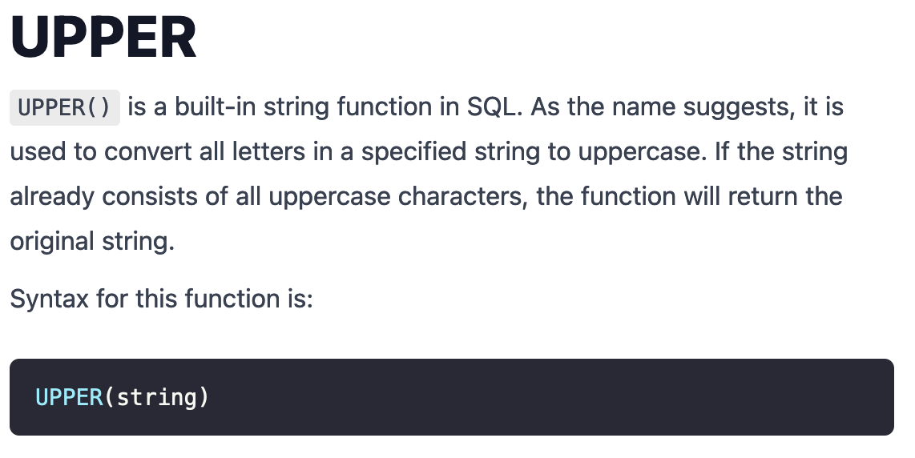
Advanced SQL Functions - (String Fns)

Slide 93
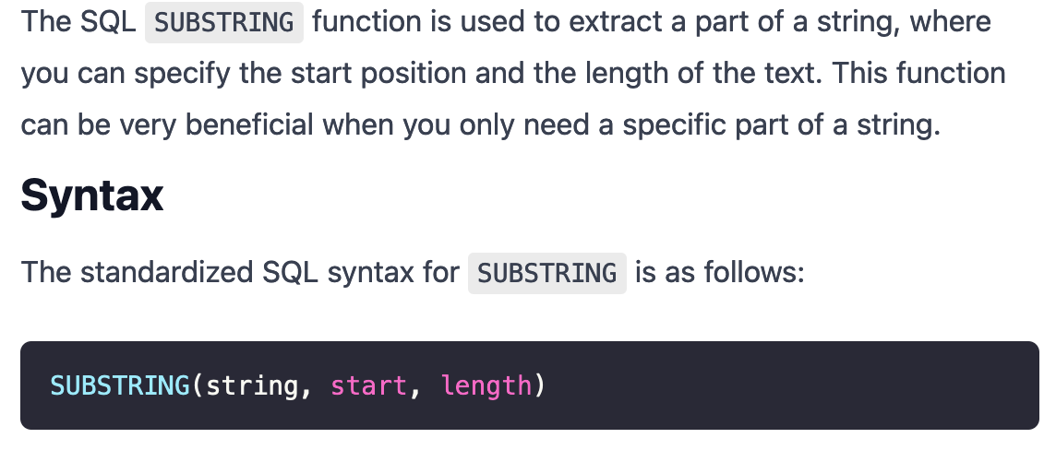
SUBSTRING

Slide 94
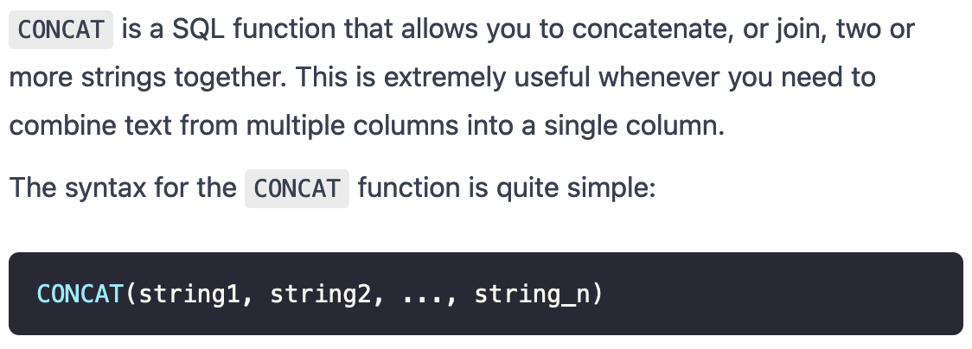
CONCAT

Slide 95
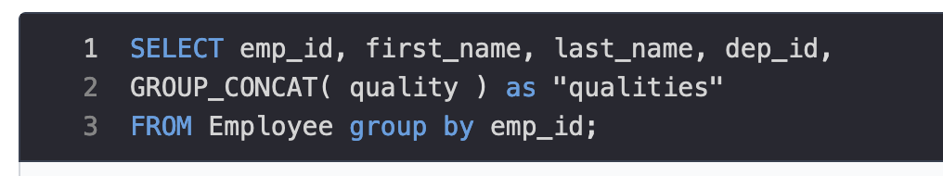
Group_Concat
The GROUP_CONCAT() function in SQL is used to concatenate data from multiple rows into one field. This is an aggregate (GROUP BY) function that returns a String value if the group contains at least one non-NULL value. Otherwise, it returns NULL.

Slide 96
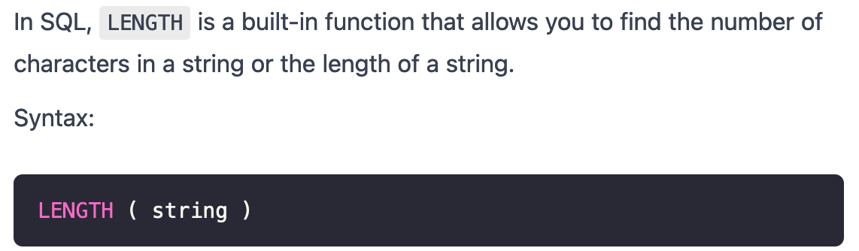
LENGTH

Slide 97
Collective Assessment
Consider the following tables in the database:
Employees (employee_id, name, age, department_id, salary)
Departments (department_id, name)
Products (product_id, name, category_id, price, quantity)
Categories (category_id, name)
Orders (order_id, customer_id, order_date, ship_date, total_amount,ship_to)
Customers (customer_id, name, email, address)

Slide 98
Questions :
Retrieve all employees from the 'Sales' department.
Find all products with a price greater than $100 and a quantity less than 50.
Calculate the average salary of all employees.
Convert all product names to uppercase.
Calculate the total sales amount for each customer and display only those with a total amount greater than $1000.
Select all orders placed in 2023 and shipped to either 'New York' or 'Los Angeles'.
Retrieve all employees whose salary is greater than 50000 and hire date is after January 1st, 2020.
Find the maximum salary among all employees.

Slide 99
SELECT * FROM Employees WHERE department_id = (SELECT department_id FROM Departments WHERE name = 'Sales');
SELECT * FROM Products WHERE price > 100 AND quantity < 50;
SELECT AVG(salary) AS average_salary FROM Employees;
SELECT UPPER(name) AS uppercase_name FROM Products;
SELECT customer_id, SUM(total_amount) AS total_sales_amount FROM Orders GROUP BY customer_id HAVING SUM(total_amount) > 1000;
SELECT * FROM Orders WHERE YEAR(order_date) = 2023 AND ship_to IN ('New York', 'Los Angeles');
SELECT * FROM Employees WHERE salary > 50000 AND hire_date > '2020-01-01';
SELECT MAX(salary) AS max_salary FROM Employees;

